Slide 1

Kamla Nehru Institute of Physical and Social Sciences, Faridipur
(Session: 2024-2025)
Department of Computer Science & Engineering
Final year Project
(KCS 851)
REAL-TIME TRAFFIC CONGESTION & ACCIDENT PREDICTION
Submitted by
Anupam Vishwakarma (2103820100014)
Naman Mishra (2103820100036)
Rishabh Yadav (2103820100043)
Shubhanshu Mishra (2103820100057)
Submitted To
Dr. Kavita Srivastava
(Project In-Change)
Under the Guidance
Priyanka Vishwakarma
(Assistant Professor, CSE - Department.)

Slide 2
Contents:
🎯 2. Project Vision
Project Objectives and Features
System Architecture and Data Flow
Comparison with Existing Systems
📘 1. Introduction & Background
Introduction
Challenges in Urban Traffic Management
Existing Solutions and Their Gaps
🧠 3. Model Design & Working
Methodology and Model Deployment
Random Forest Classifier
Random Forest Regressor
🛠️ 4. System Implementation
Implementation and Performance
UI Screenshots-1
UI Screenshots-2
Results
📝 5. Conclusion & Credits
Conclusion
Future Work
Acknowledgement and Reference

Slide 3
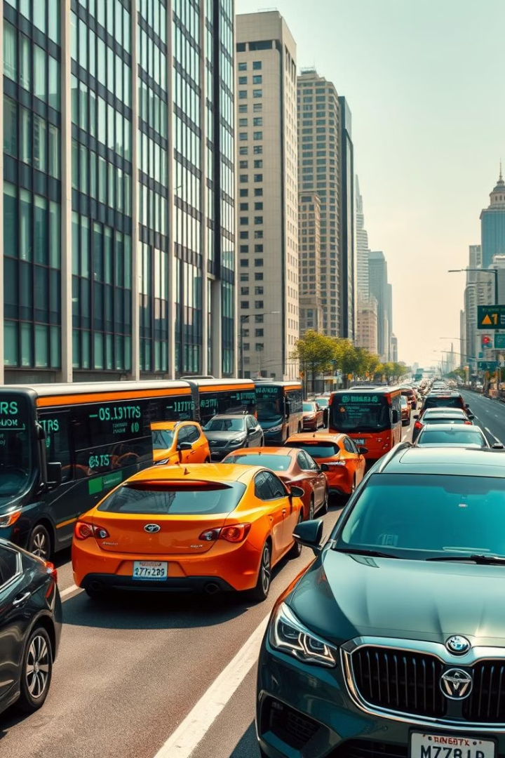
Introduction
Real-Time Traffic Congestion & Accident Prediction
This research project by final year B.Tech students from Kamla Nehru Institute proposes a machine learning system to predict traffic congestion and accident-prone zones in real time. It integrates live traffic, weather data, and historical trends to enhance urban mobility and safety. The system uses Random Forest algorithms and offers over 90% accuracy in congestion prediction and 85% in accident risk classification.

Slide 4
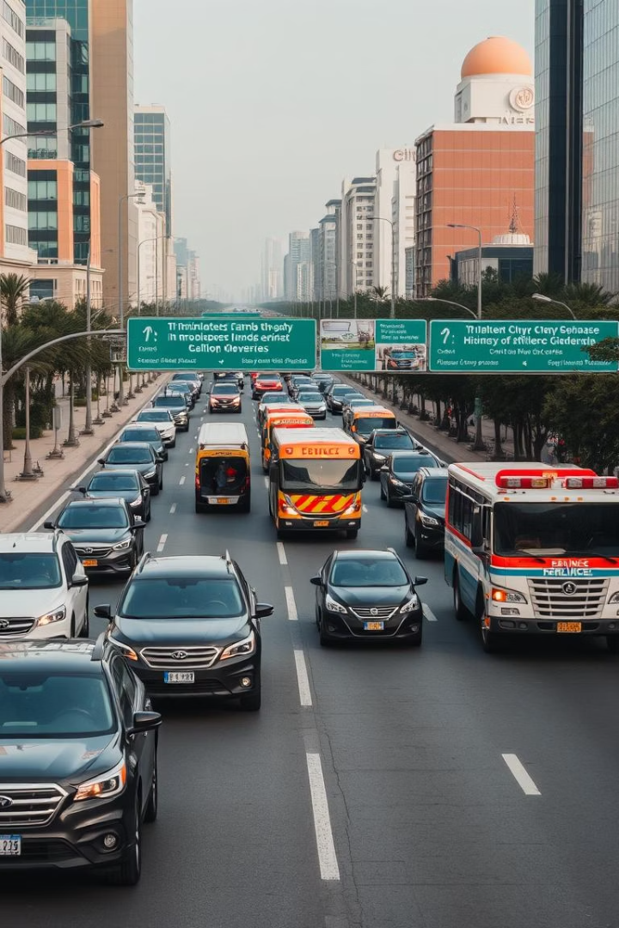
Challenges in Urban Traffic Management
Traffic Congestion Issues
Road Accident Concerns
Rapid urbanization and vehicle growth cause bottlenecks, longer travel times, increased fuel use, and economic losses.
Accidents often occur in dense traffic zones due to poor road design, weather, and inadequate traffic systems, stressing emergency services.
Limitations of Traditional Systems
Fixed signals and manual monitoring are reactive, lacking predictive capabilities needed for proactive traffic and safety management.

Slide 5
Existing Solutions and Their Gaps
Popular Navigation Apps
Industrial Platforms
Google Maps provides real-time updates but lacks predictive analytics.
IBM Watson IoT uses deep learning but requires costly infrastructure.
Waze relies on crowd-sourced data, which can be inconsistent.
Academic models often miss real-time adaptability and data fusion.

Slide 6
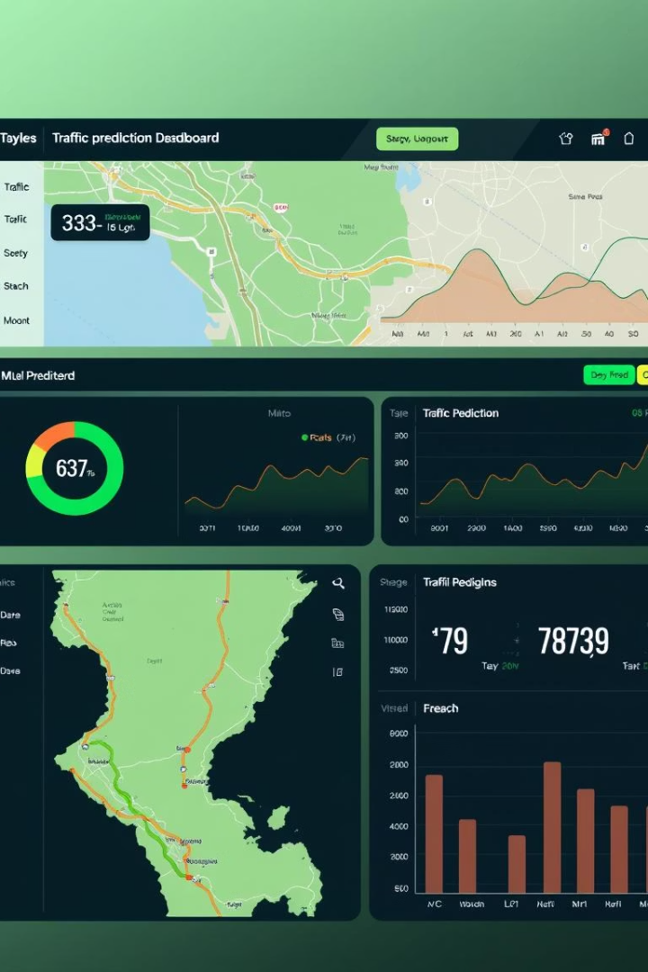
Project Objectives and Features
Accurate Congestion Prediction
Using live traffic and weather data to forecast congestion levels dynamically.
Accident Risk Identification
Analyzing historical incidents to detect high-risk zones and provide early warnings.
User-Friendly Interface
Real-time map visualization with route suggestions and severity-based risk zones.
Scalable Architecture
Designed for easy expansion to multiple cities and integration with smart city initiatives.

Slide 7

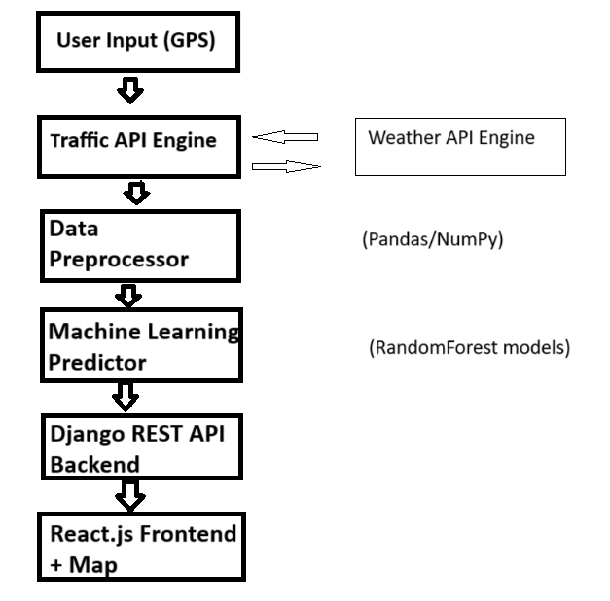




System Architecture and Data Flow
User Input
Location data entered by users initiates the process.
Data Fetching
APIs retrieve live traffic and weather data from TOMTOM and OpenWeather.
Machine Learning Prediction
Random Forest models analyze data to predict congestion and accident risks.
Results Display
Predictions are visualized on an interactive map dashboard for users.

Slide 8
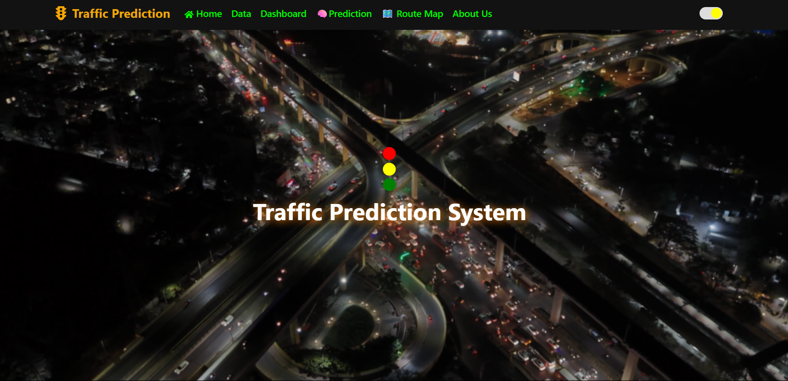
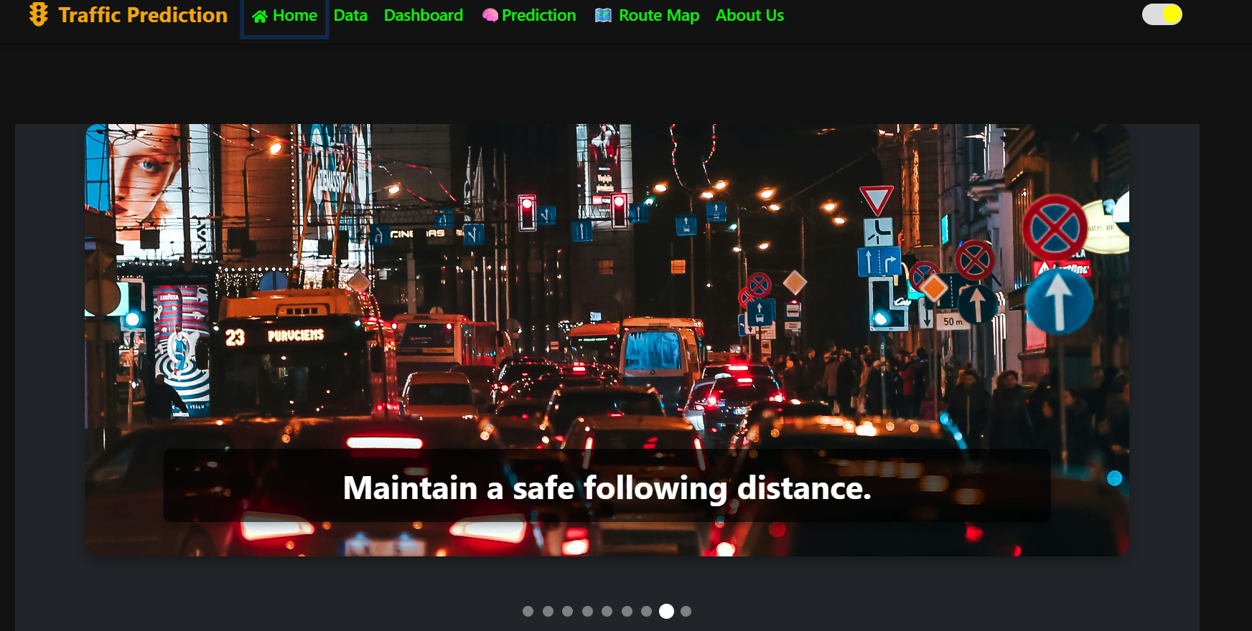
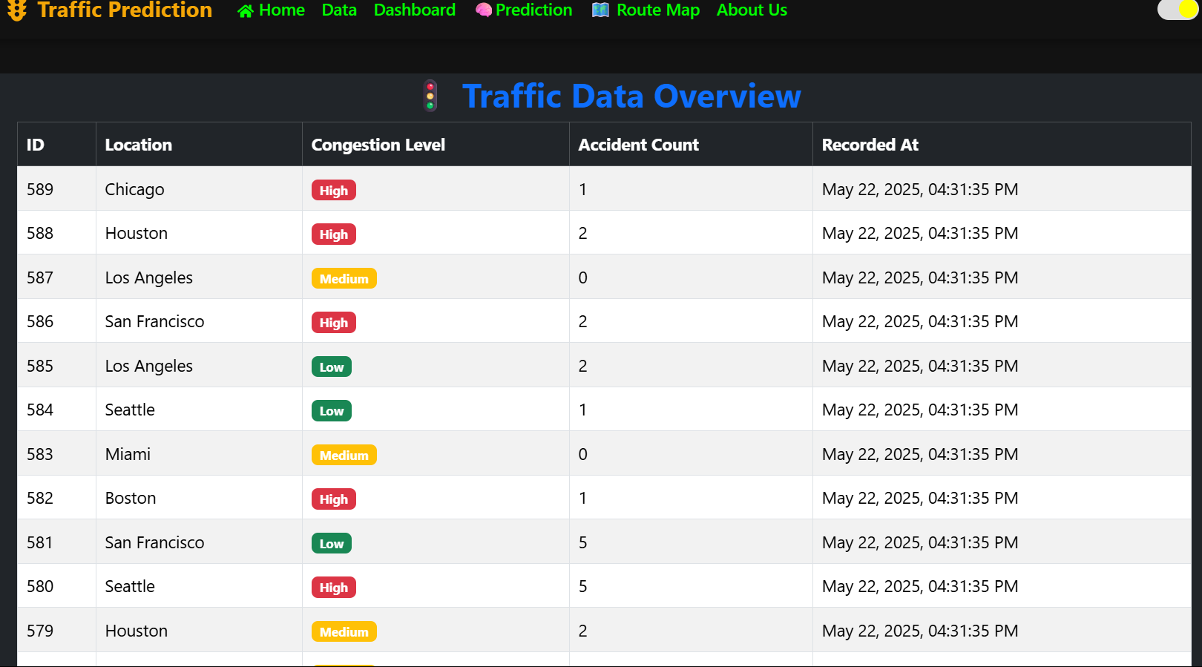
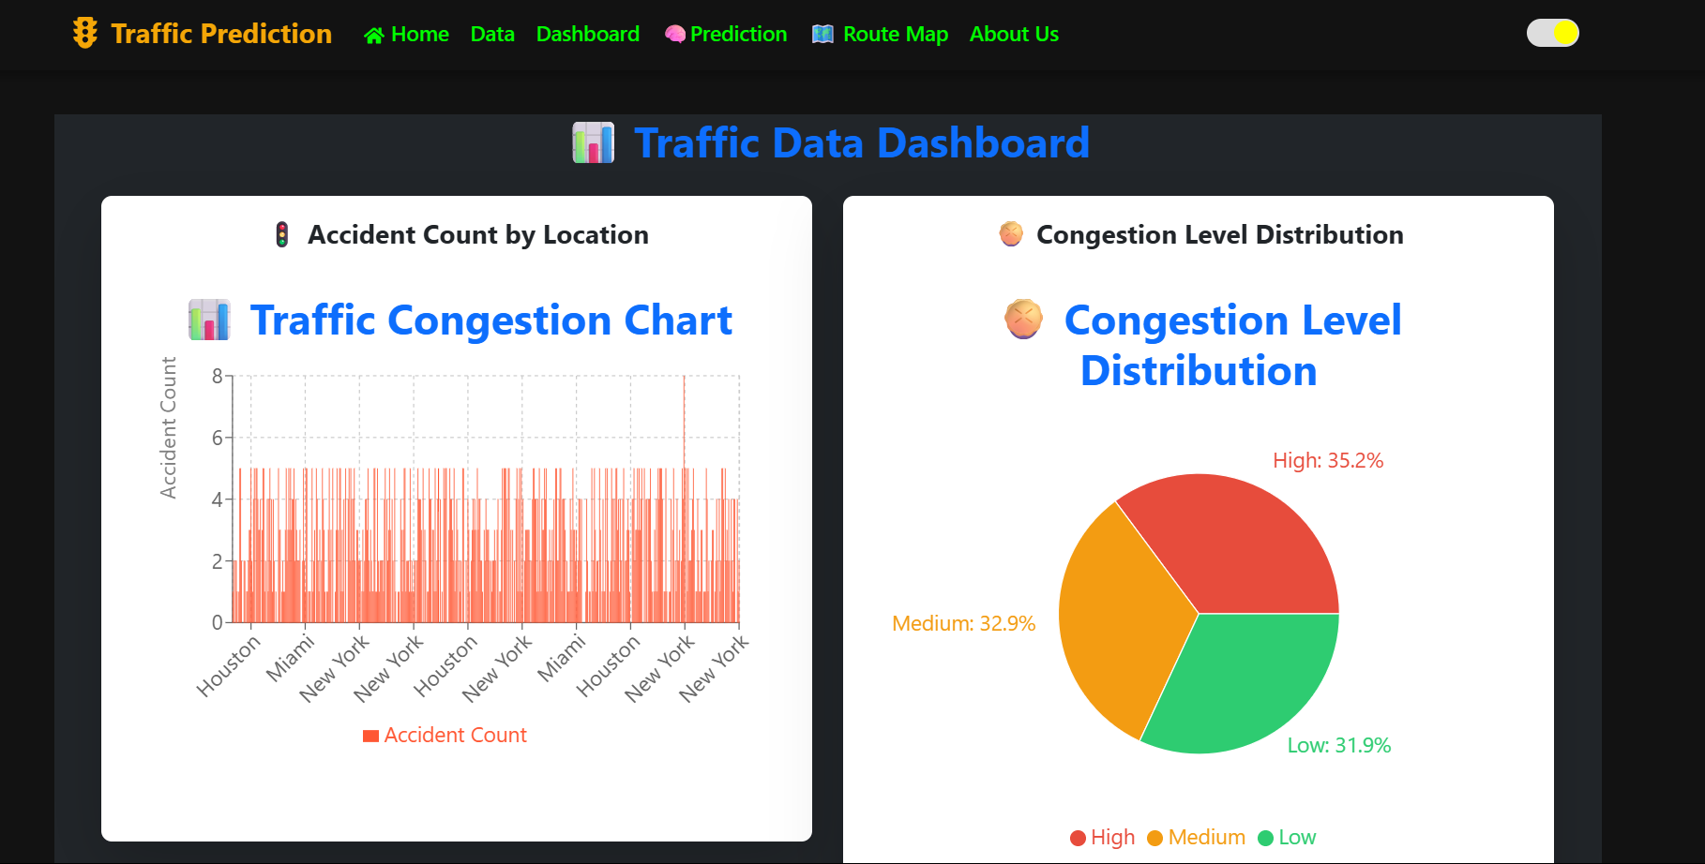
UI Screenshots
of the REAL-TIME TRAFFIC CONGESTION & ACCIDENT PREDICTION

Slide 9
Methodology and Model Deployment
Data Preparation
Model Training
Integration
Real-time and historical traffic and weather data cleaned and structured using Pandas and NumPy.
Random Forest Regressor predicts congestion; Random Forest Classifier identifies accident risk zones.
Models saved as .pkl files, loaded in Django backend, and exposed via REST API endpoints for real-time use.

Slide 10
Random Forest Classifier
Collect and label training data
Create random subsets of data and features
Train multiple decision trees independently
Each tree gives a class label prediction
Use majority vote to decide final output
Input Data
Random Sampling
Multiple Trees
Majority Voting

Slide 11
Random Forest Regressor
Collect and preprocess numerical data
Generate random subsets of data and features
Train multiple decision trees on these subsets
Each tree makes a numeric prediction
Average the outputs of all trees for final result
Input Data
Random Sampling
Multiple Trees
Average Output

Slide 12
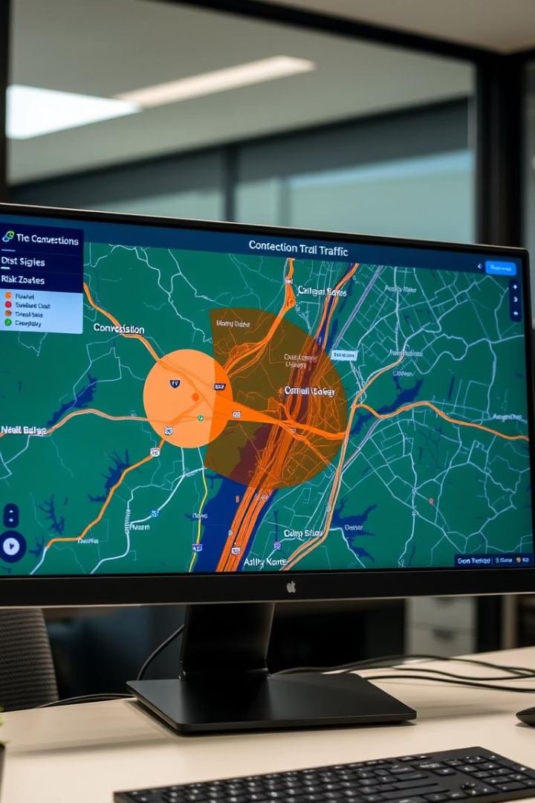
Implementation and Performance
Backend
Frontend
Django REST Framework powers APIs for live data, predictions, and user management.
React.js with Redux manages dynamic UI showing live maps, congestion, and accident risk.
Deployment
Cloud-hosted on Render with load balancing and auto-scaling for high availability.

Slide 13
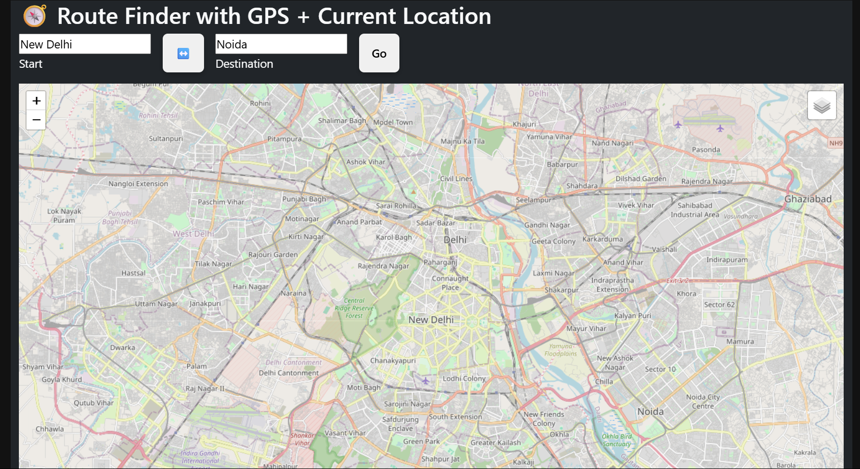
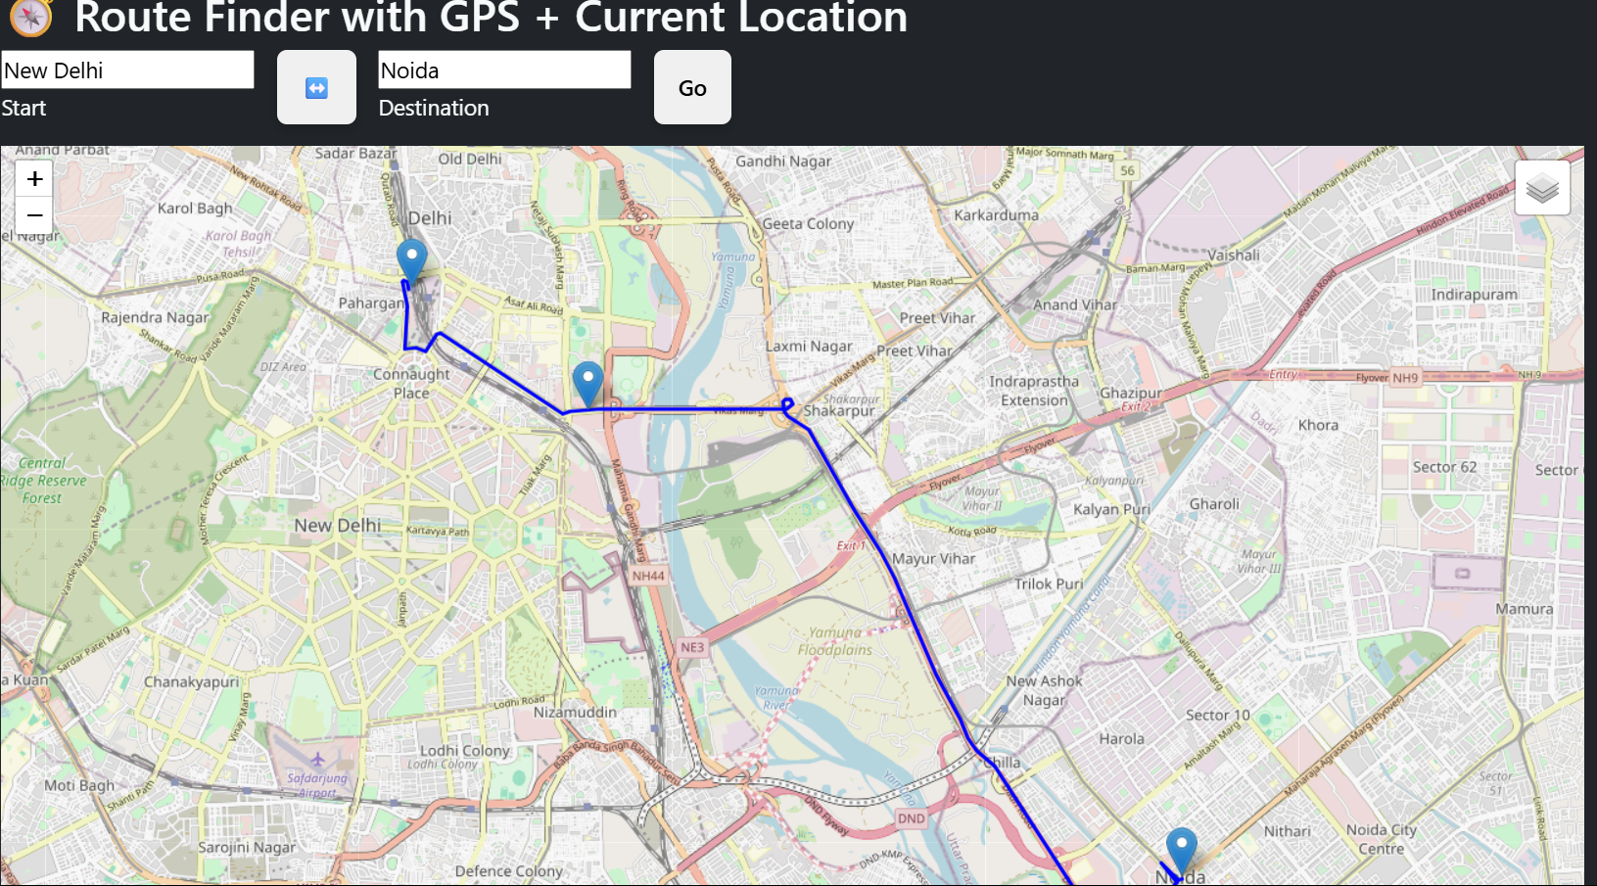
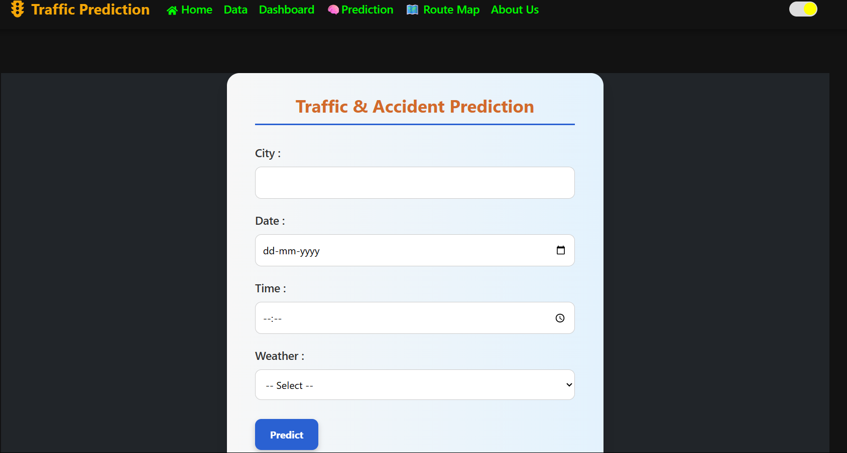
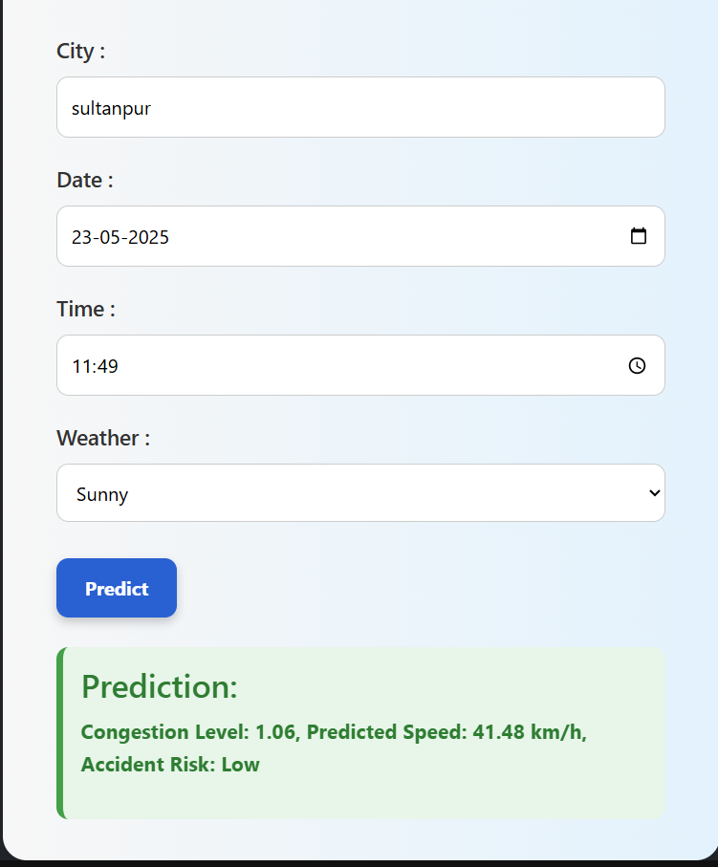
UI Screenshots
of the Map and Prediction

Slide 14
Comparison with Existing Systems
Feature | Google Maps | Waze | Your System
Real-time traffic info | ✅ | ✅ | ✅
Predictive analytics | ❌ | ❌ | ✅
Accident hotspot detection | ❌ | ❌ | ✅
Weather-based optimization | ❌ | ❌ | ✅
Open-source and customizable | ❌ | ❌ | ✅

Slide 15

Results
Congestion prediction accuracy: ~90%
Accident risk classification accuracy: 85–88%
Weather data integration improved accuracy by ~9%
Machine learning models tested on real-time and historical datasets
Model performance validated using cross-validation techniques
Interactive dashboard displays results on real-time traffic maps

Slide 16
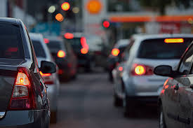
Conclusion
Project Success
1
Developed effective REAL-TIME TRAFFIC CONGESTION & ACCIDENT PREDICTION System
2
Improvements
Enhanced communication and resource sharing
Future Work
3
Integrate with learning management systems
Add AI-powered features

Slide 17

Future Work
Mobile application development
AI-powered traffic light control
Integration with autonomous vehicle networks
Smart city integration
Data analytics dashboard for authorities
Multi-city scalability & customization
Predictive maintenance alerts

Slide 18
Acknowledgement and Reference
Acknowledgement
Reference
Faculty Advisor: Miss Priyanka Vishwakarma
Team Members: Anupam Vishwakarma
Naman Mishra
Rishabh Yadav
Shubhanshu Mishra
3. College Administration Support
Django Official Documentation – https://docs.djangoproject.com/
React.js Official Docs – https://react.dev/
Scikit-learn (ML Models) – https://scikit-learn.org/stable/
Pandas & NumPy for Data Preprocessing – https://pandas.pydata.org/docs/
TomTom API – https://developer.tomtom.com/
OpenWeather API – https://openweathermap.org/api
Government Traffic Data (Accidents & Congestion) – https://data.gov/

Slide 19


